Slide 1
MEDB 5510 Clinical Research Methods
Week 7 – Part 1
Internal Validity
Notes:
Homework

Slide 2
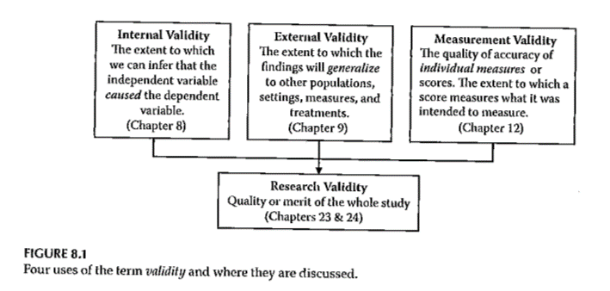
Validity

Slide 3
Internal Validity
“The extent to which we can infer that the independent variable caused the dependent variable.”
For non-experimental studies –
How “well designed and conducted” was the study?
Three criteria for causality

Slide 4
Internal Validity
“The extent to which we can infer that the independent variable caused the dependent variable.”
Three criteria for causality
IV must precede the outcome variable
IV must be related to the outcome
There must be no other variables that could explain why the IV is related to the outcome

Slide 5
Internal Validity
Three criteria for causality –
IV must precede the outcome variable
IV must be related to the outcome
There must be no other variables that could explain why the IV is related to the outcome
By Research Approach –
Randomized Exp
Quasi-Exp
Comparative
Associational
Descriptive

Slide 6
Internal Validity
Criteria for Causality | Randomized Exp | Quasi-Exp | Comparative | Associational | Descriptive
IV must precede the outcome variable | Met | Often met | Sometimes met, but order might not be clear | Sometimes met, but order might not be clear | NA
IV must be related to the outcome | Met | Usually met | Usually met | Usually met | NA
There must be no other variables that could explain why the IV is related to the outcome | Met | Met in the strongest designs | Not possible | Not possible | NA

Slide 7
Internal Validity
Meeting the 3 causality criteria based on –
Strength of the research design
Internal validity

Slide 8
Internal Validity
Internal validity -
Most often discussed with reference to randomized experimental and quasi-experimental designs
Can also be applied to non-experimental studies

Slide 9
Internal Validity
Evaluating the internal validity of a study –
Equivalence of the groups on participant characteristics
Control of extraneous experiences and environmental variables

Slide 10
Internal Validity
Equivalence of the groups on participant characteristics –
Are groups equivalent prior to introduction of IV?
Randomized experimental design –
Random assignment
Quasi-experimental design –
Random assignment of treatments
Matching
Checking pretest scores

Slide 11
Internal Validity
Equivalence of the groups on participant characteristics –
Are groups equivalent prior to introduction of IV?
Comparative design –
Statistical adjustment (ANCOVA) to adjust DV scores to make groups more nearly equivalent
Matching participants on variables other than the primary IV
E.g. Case-control study
Check after the study for comparability

Slide 12
Internal Validity
Equivalence of the groups on participant characteristics –
Are groups equivalent prior to introduction of IV?
Associational design –
Only 1 group
Not able to provide evidence of causation
“Equivalence” – “… whether those who score high on the IV … are similar to those … who score low in terms of other attributes that may be related to the DV.”
May be able to provide some statistical control

Slide 13
Internal Validity
Control of extraneous experiences and environmental variables –
Extraneous variables – variables other than the IV and DV
Environmental variables – conditions/variables that occur during the study
Contamination
Issue – Is one group affected more than the other(s)?
Less of an issue with a more controlled research setting

Slide 14
Internal Validity
Rating the dimensions of internal validity
Figure 8.2
Evaluating Research Validity framework
“Good” study – moderate to high internal validity on both dimensions

Slide 15
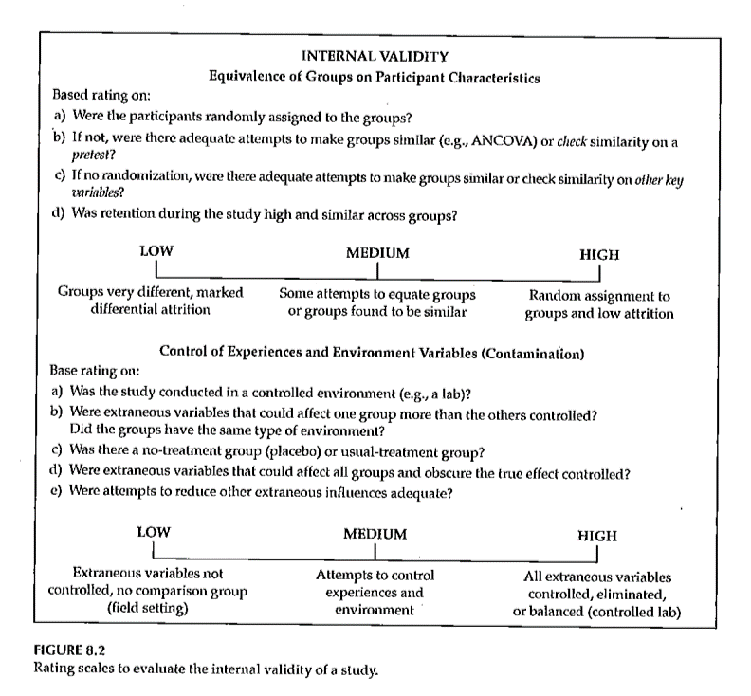
Internal Validity
Rating the dimensions of internal validity

Slide 16
Threats to Internal Validity

Slide 17
Threats to Internal Validity
Equivalence of Groups
Use of extreme groups
Participant dropouts or attrition during the study
Bias in assignment to groups

Slide 18
Threats to Internal Validity
Control of extraneous/environmental variables
Changes due to time or growth and development
Extraneous environmental events
Repeated testing, carryover effects
Instrument or observer inconsistency
Combinations of two or more threats
Did the IV actually occur before the DV?

Slide 19
Threats to Internal Validity
Other threats
Effects of being in the control group
Expectation effect
Control for expectation
Observer / experimenter bias

Slide 20
Validity

